Slide 1
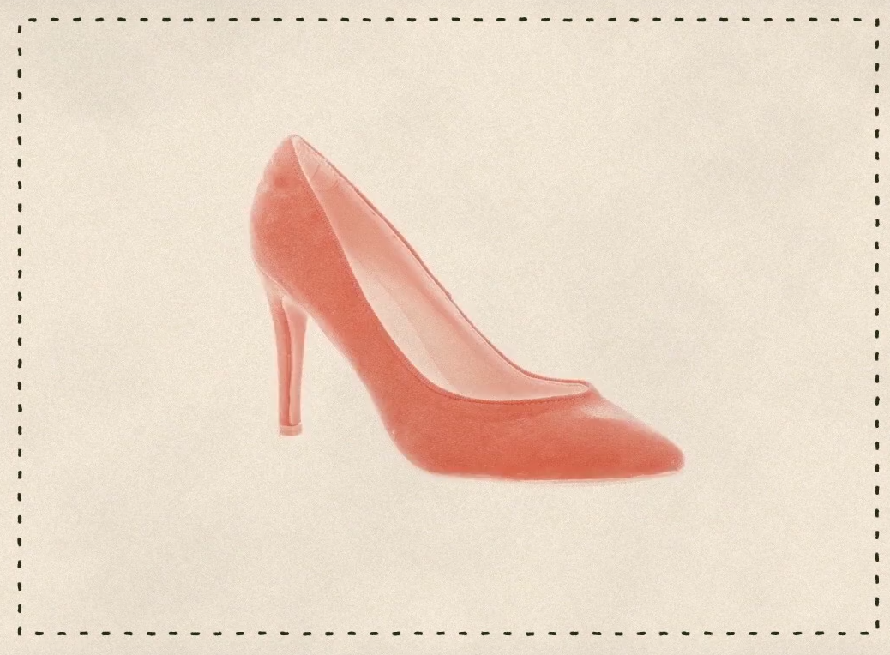
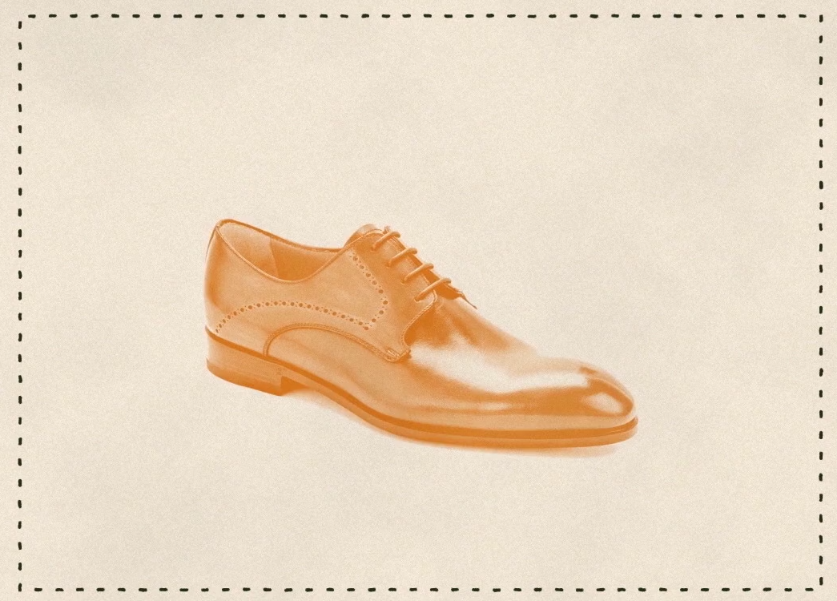
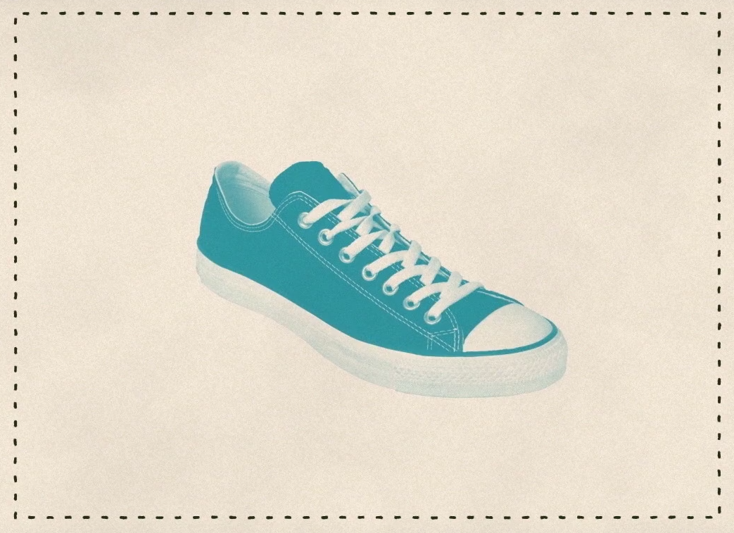
Close your eyes and picture
a
shoe

Slide 2
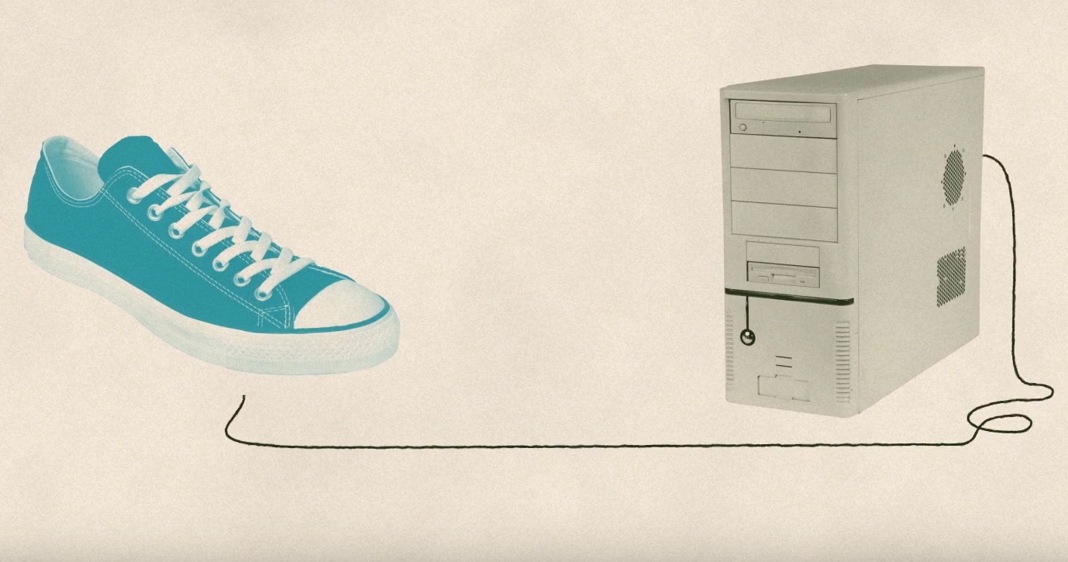
Now think about teaching this to a computer

Slide 3
So what is Machine learning ?

Slide 4
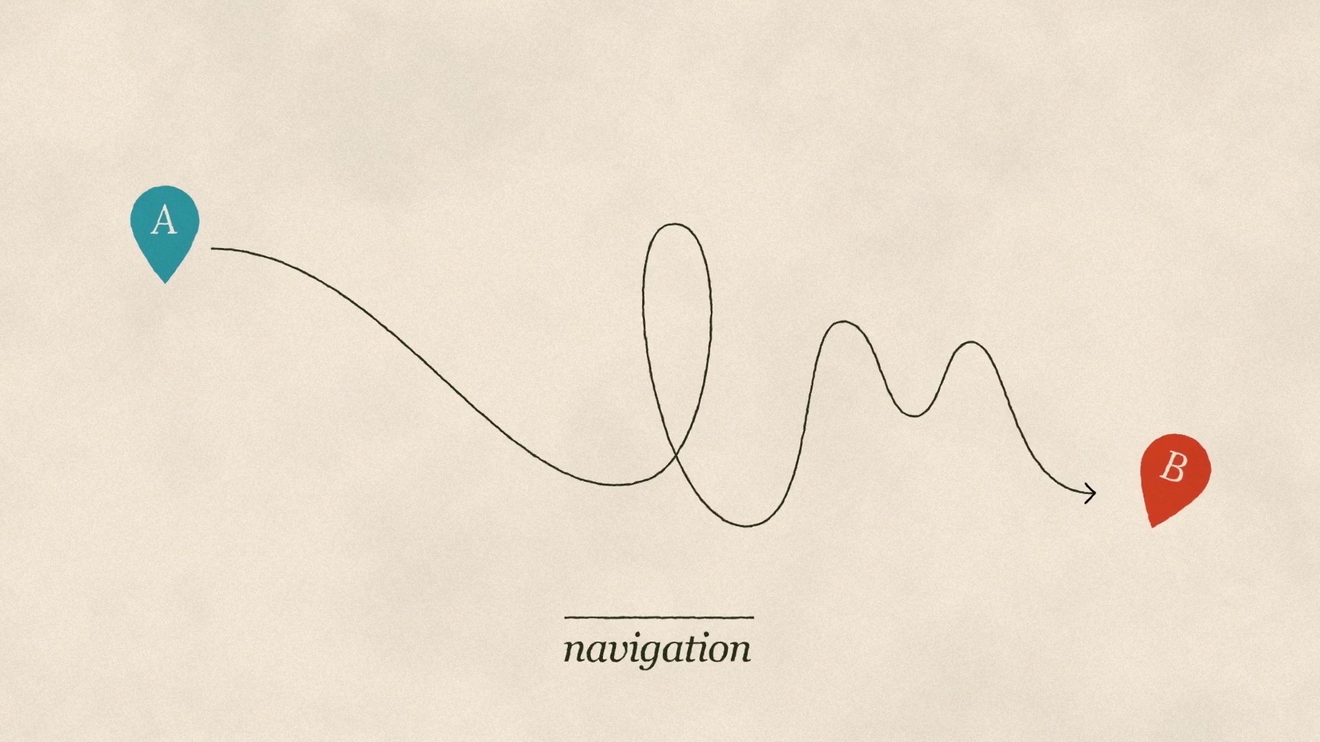
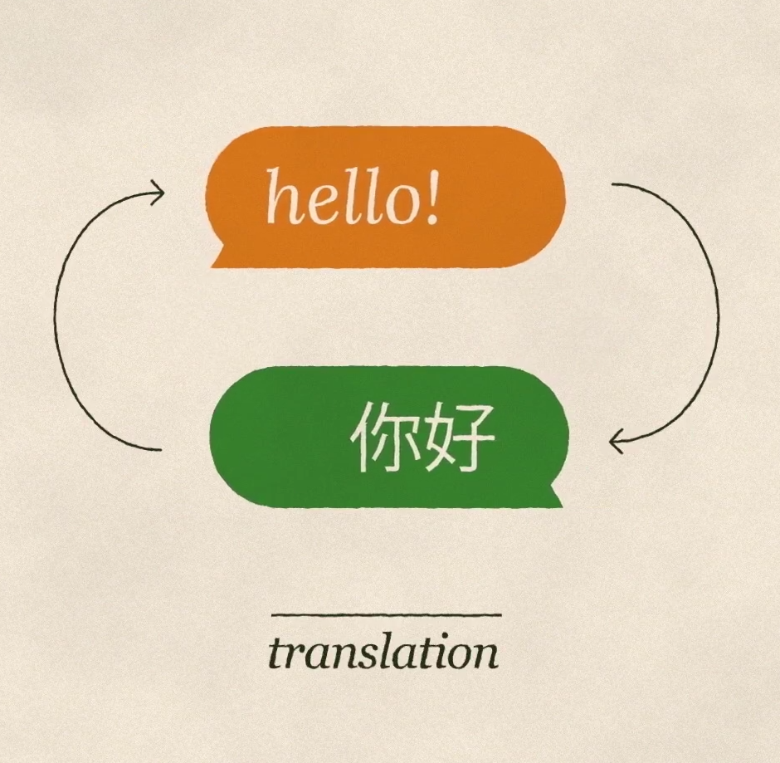
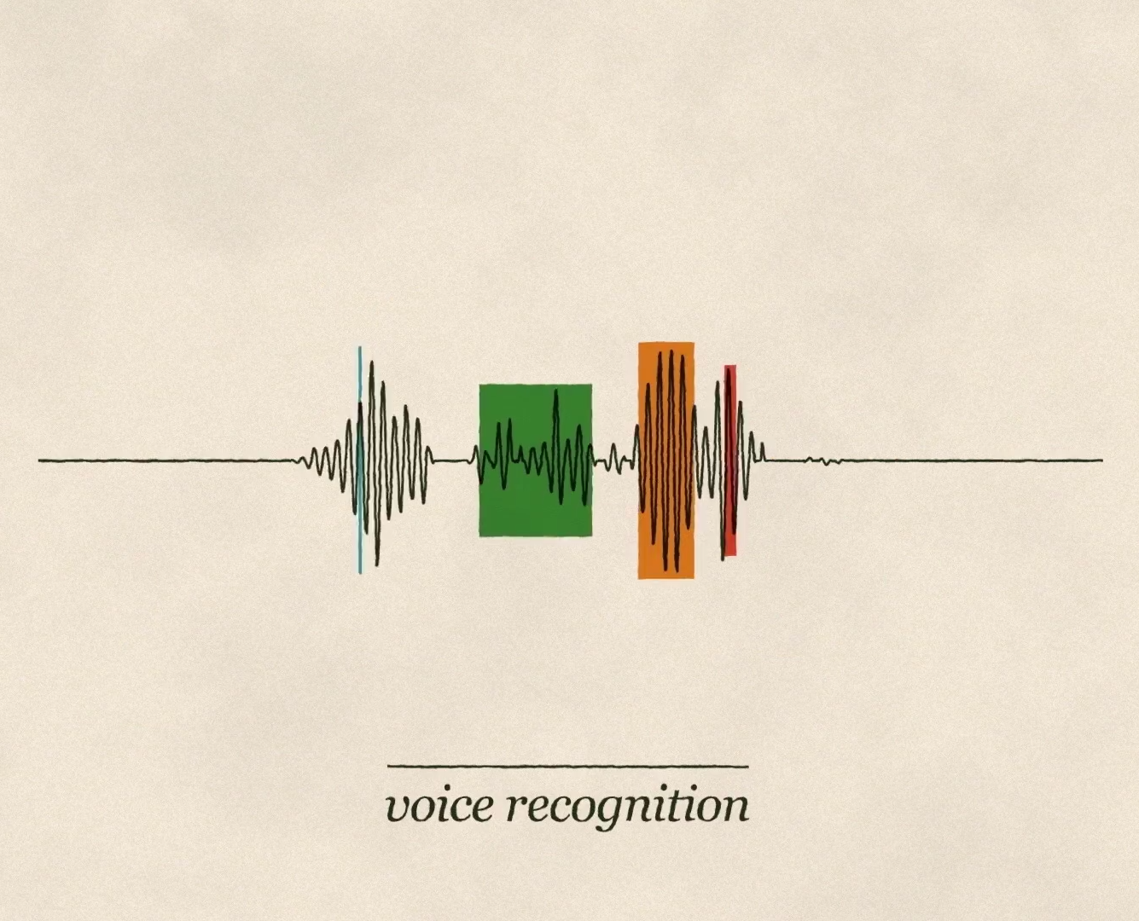

Slide 5
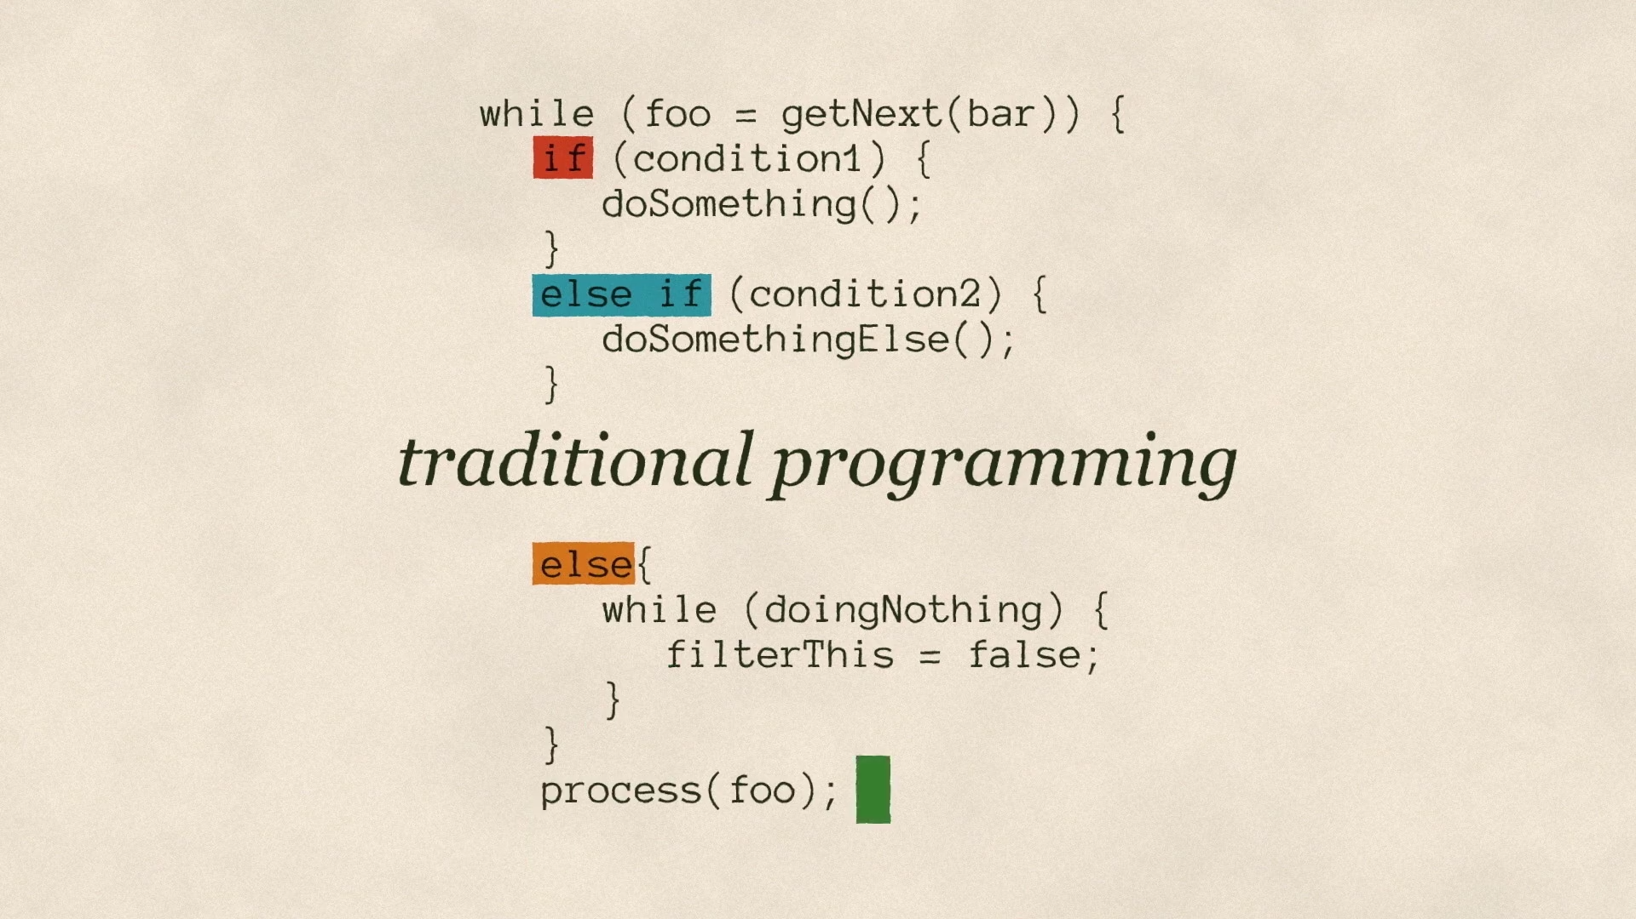

Slide 6
Traditional Programming
Machine Learning
Computer
Data
Output
Program
Data
Computer
Program
Output

Slide 7

Magic?
No, more like gardening
Seeds = Algorithms
Nutrients = Data
Gardener = You
Plants = Programs

Slide 8
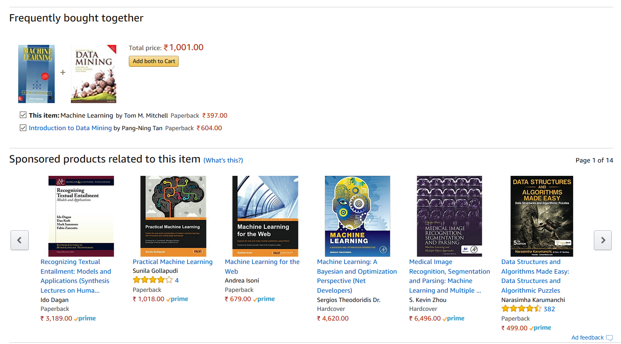
Recommendation system

Slide 9
A Few Quotes
“A breakthrough in machine learning would be worth ten Microsofts” (Bill Gates, Chairman, Microsoft)
“Machine learning is the next Internet” (Tony Tether, Director, DARPA)
Machine learning is the hot new thing” (John Hennessy, President, Stanford)
“Web rankings today are mostly a matter of machine learning” (Prabhakar Raghavan, Dir. Research, Yahoo)
“Machine learning is going to result in a real revolution” (Greg Papadopoulos, CTO, Sun)
“Machine learning is today’s discontinuity” (Jerry Yang, CEO, Yahoo)

Slide 10
What is Learning?
“Learning denotes changes in a system that ... enable a system to do the same task … more efficiently the next time.” - Herbert Simon
“Learning is constructing or modifying representations of what is being experienced.” - Ryszard Michalski
“Learning is making useful changes in our minds.” - Marvin Minsky
“Machine learning refers to a system capable of the autonomous acquisition and integration of knowledge.”

Slide 11
Machine Learning
Machine Learning (Mitchell 1997)
Learn from past experiences
Improve the performances of intelligent programs
Definitions (Mitchell 1997)
A computer program is said to learn from experience E with respect to some class of tasks T and performance measure P, if its performance at the tasks improves with the experiences

Slide 12
So Why Machine Learning?
Automating automation
Getting computers to program themselves
Writing software is the bottleneck
Let the data do the work instead!

Slide 13
Sample Applications
Web search
Computational biology
Finance
E-commerce
Space exploration
Robotics
Information extraction
Social networks
Debugging
[Your favorite area]

Slide 14
ML in a Nutshell
Tens of thousands of machine learning algorithms
Hundreds new every year
Every machine learning algorithm has three components:
Representation
Evaluation
Optimization

Slide 15
Representation
Decision trees
Sets of rules / Logic programs
Instances
Graphical models (Bayes/Markov nets)
Neural networks
Support vector machines
Model ensembles
Etc.

Slide 16
Evaluation
Accuracy
Precision and recall
Squared error
Likelihood
Posterior probability
Cost / Utility
Margin
Entropy
K-L divergence
Etc.

Slide 17
Optimization
Combinatorial optimization
E.g.: Greedy search
Convex optimization
E.g.: Gradient descent
Constrained optimization
E.g.: Linear programming

Slide 18
Examples
Text Classification
Task T
Assigning texts to a set of predefined categories
Performance measure P
Precision and recall of each category
Training experiences E
A database of texts with their corresponding categories
How about Disease Diagnosis?
How about Chess Playing?

Slide 19
Example 1: Text Classification
Classified text files
Text file 1 trade
Text file 2 ship
… …
Training
Text classifier
class
New text file

Slide 20
Example 2: Disease Diagnosis
Database of medical records
Patient 1’s data Absence
Patient 2’s data Presence
… …
Training
Disease classifier
New patient’s data
Presence or absence

Slide 21
Example 3: Chess Playing
Games played:
Game 1’s move list Win
Game 2’s move list Lose
… …
Training
New matrix representing the current board
Strategy of Searching and Evaluating
Best move

Slide 22
Why Machine Learning Is Possible?
Mass Storage
More data available
Higher Performance of Computer
Larger memory in handling the data
Greater computational power for calculating and even online learning

Slide 23
Advantages
Alleviate Knowledge Acquisition Bottleneck
Does not require knowledge engineers
Scalable in constructing knowledge base
Adaptive
Adaptive to the changing conditions
Easy in migrating to new domains

Slide 24
Success of Machine Learning
Almost All the Learning Algorithms
Text classification (Dumais et al. 1998)
Gene or protein classification optionally with feature engineering (Bhaskar et al. 2006)
Reinforcement Learning
Backgammon (Tesauro 1995)
Learning of Sequence Labeling
Speech recognition (Lee 1989)
Part-of-speech tagging (Church 1988)
Computer Vision

Slide 25
Machine Learning Problems
Choosing the Training Experience
Sometimes straightforward
Text classification, disease diagnosis
Sometimes not so straightforward
Chess playing
Other Attributes
How the training experience is controlled by the learner?
How the training experience represents the situations in which the performance of the program is measured?

Slide 26
Choosing the Target Function
Choosing the Target Function
What type of knowledge will be learned?
How it will be used by the program?
Reducing the Learning Problem
From the problem of improving performance P at task T with experience E
To the problem of learning some particular target functions

Slide 27
Solving Real World Problems
What Is the Input?
Features representing the real world data
What Is the Output?
Predictions or decisions to be made
What Is the Intelligent Program?
Types of classifiers, value functions, etc.
How to Learn from experience?
Learning algorithms

Slide 28
Feature Engineering
Representation of the Real World Data
Features: data’s attributes which may be useful in prediction
Feature Transformation and Selection
Select a subset of the features
Construct new features, e.g.
Discretization of real value features
Combinations of existing features
Post Processing to Fit the Classifier
Does not change the nature

Slide 29
Intelligent Programs
Value Functions
Input: features
Output: value
Classifiers (Most Commonly Used)
Input: features
Output: a single decision
Sequence Labeling
Input: sequence of features
Output: sequence of decisions

Slide 30
Examples of Value Functions
Linear Regression
Input: feature vectors
Output:
Logistic Regression
Input: feature vectors
Output:

Slide 31
Examples of Classifiers
Linear Classifier
Input: feature vectors
Output:
Rule Classifier
Decision tree
A tree with nodes representing condition testing and leaves representing classes
Decision list
If condition 1 then class 1 elseif condition 2 then class 2 elseif ….

Slide 32
Examples of Learning Algorithms
Parametric Functions or Classifiers
Given parameters of the functions or classifier, e.g.
Linear functions or classifiers: w, b
Estimating the parameters, e.g.
Loss function optimization
Rule Learning
Condition construction
Rules induction using divide-and-conquer

Slide 33
Some Real life applications
Systems Biology – Gene expression microarray data:
Text categorization: spam detection
Face detection: Signature recognition: Customer discovery
Medicine: Predict if a patient has heart ischemia by a spectral analysis of his/her ECG.

Slide 34

Microarray data
Separate malignant from healthy tissues based on the mRNA expression profile of the tissue.

Slide 35
Text Categorization (multi category)
Categorize text documents into predefined categories . For example, categorize news into ‘sports’, ‘politics’, ‘science’, etc.
Soft tissue found in T-rex fossil
Find may reveal details about cells and blood vessels of dinosaurs
Thursday, March 24, 2005 Posted: 3:14 PM EST
WASHINGTON (AP) -- For more than a century, the study of dinosaurs has been limited to fossilized bones. Now, researchers have recovered 70-million-year-old soft tissue, including what may be blood vessels and cells, from a Tyrannosaurus rex.
Health may be concern when giving kids cell phones
Wednesday, March 23, 2005 Posted: 11:14 AM EST
SEATTLE, Washington (AP) -- Parents should think twice before giving in to a middle-schooler's demands for a cell phone, some scientists say, because potential long-term health risks remain unclear.
Wall Street gears up for jobs Saturday, March 26, 2005: 11:41 AM EST
NEW YORK (CNN/Money) - Investors on Inflation Watch 2005 have a big week to look forward to -- or be wary of -- depending on how you look at it.
Probe finds atmosphere on Saturn moon
Thursday, March 17, 2005 Posted: 11:17 AM EST
LOS ANGELES, California (Reuters) -- The space probe Cassini discovered a significant atmosphere around Saturn's moon Enceladus during two recent passes close by, the Jet Propulsion Laboratory said on Wednesday

Slide 36
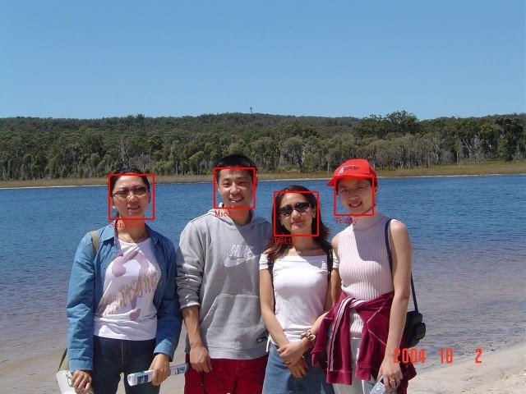
Face detection
discriminating human faces from non faces.

Slide 37
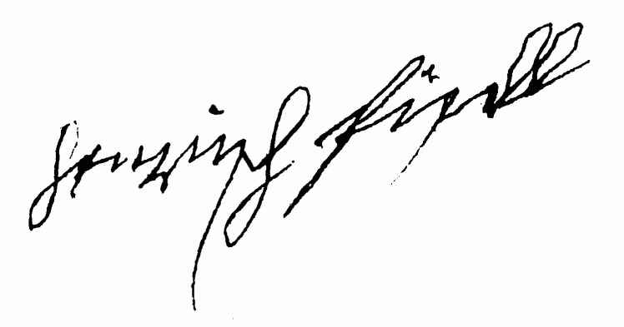
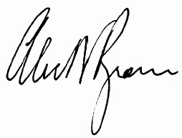
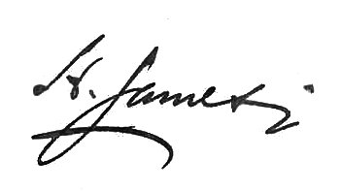
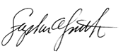
Signature recognition
Recognize signatures by structural similarities which are difficult to quantify.
does a signature belongs to a specific person, say Tony Blair, or not.

Slide 38
Customer discovery
predict whether a customer is likely to purchase certain goods according to a database of customer profiles and their history of shopping activities.

Slide 39
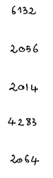
Character recognition (multi category)
6132
2056
2014
4283
2064
Identify handwritten characters: classify each image of character into one of 10 categories ‘0’, ‘1’, ‘2’ …

Slide 40
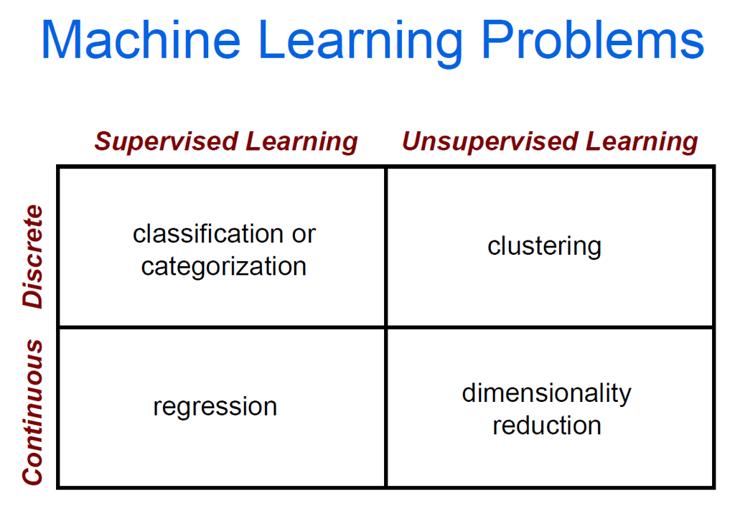

Slide 41
Clustering Strategies
K-means
Iteratively re-assign points to the nearest cluster center
Agglomerative clustering
Start with each point as its own cluster and iteratively merge the closest clusters
Mean-shift clustering
Estimate modes of pdf
Spectral clustering
Split the nodes in a graph based on assigned links with similarity weights

Slide 43
Classification problem
x₂
?
?
?
?
x₁

Slide 45
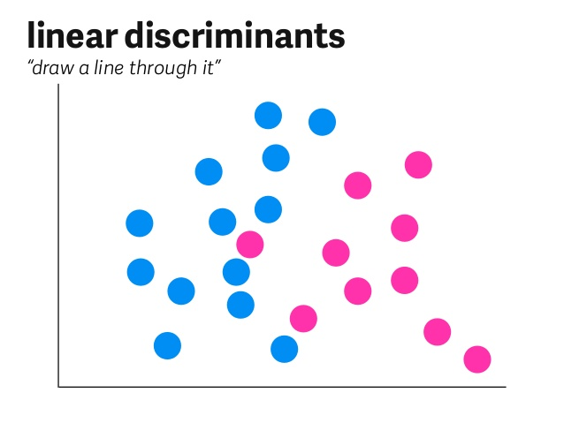

Slide 46
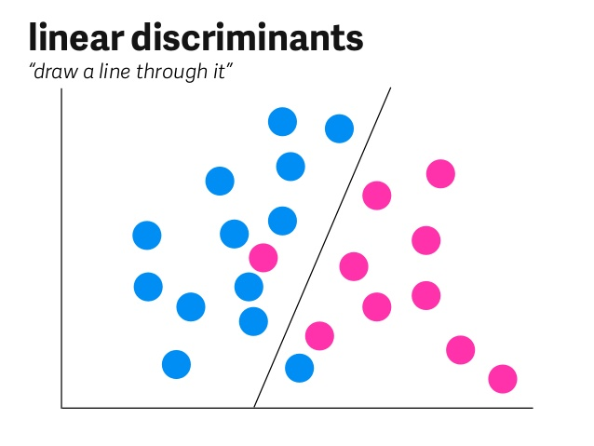

Slide 47
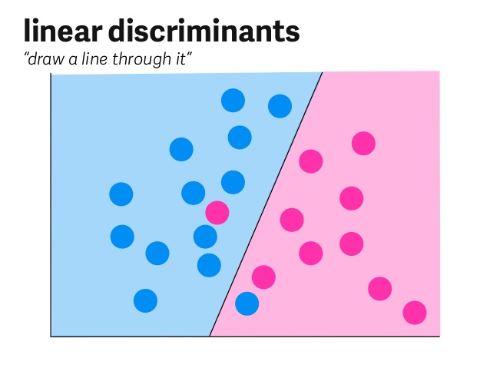

Slide 48
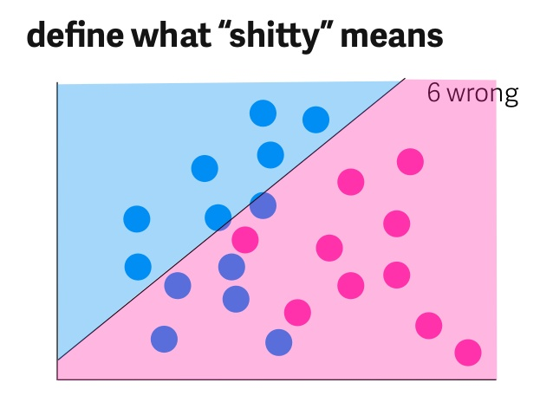

Slide 49
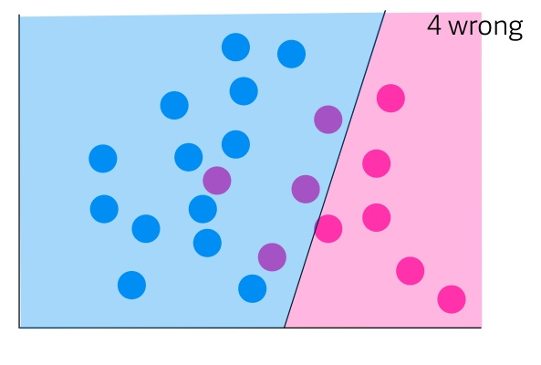
Defining a bad classifier

Slide 50
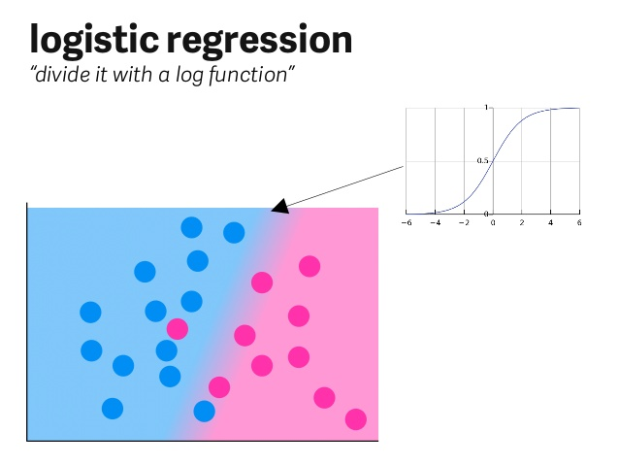

Slide 52
Support Vector Machines
“Advanced Draw a Line through it”
Lines can turn into non linear shapes by transforming our data

Slide 53
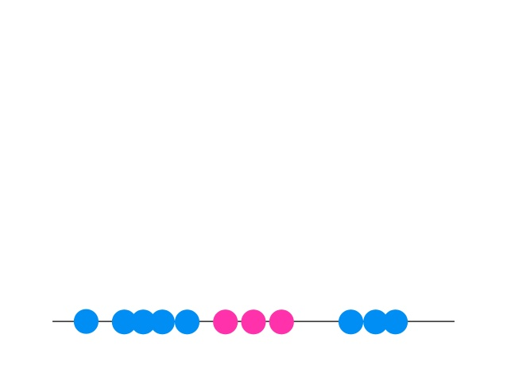

Slide 54
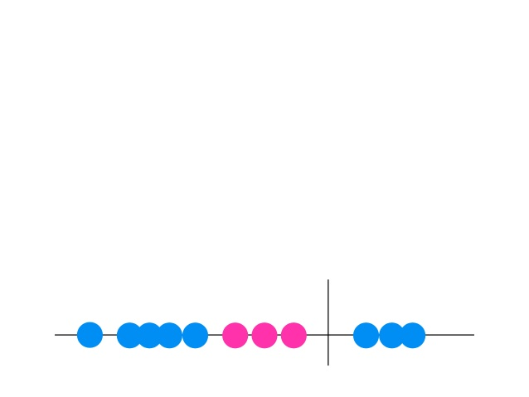

Slide 55


Slide 56
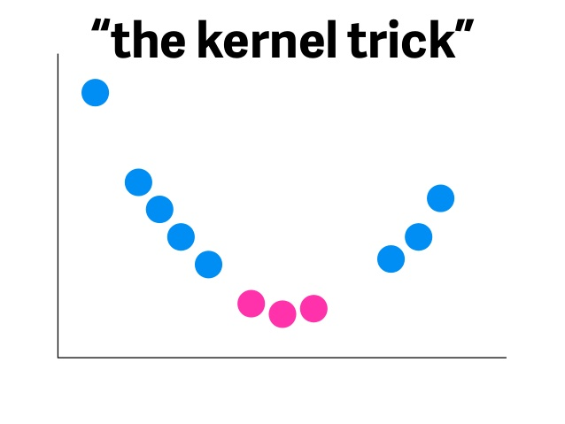

Slide 57
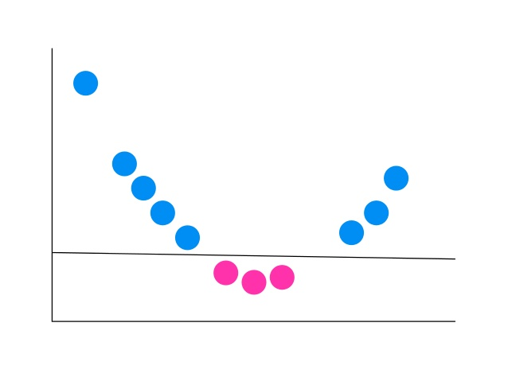

Slide 58
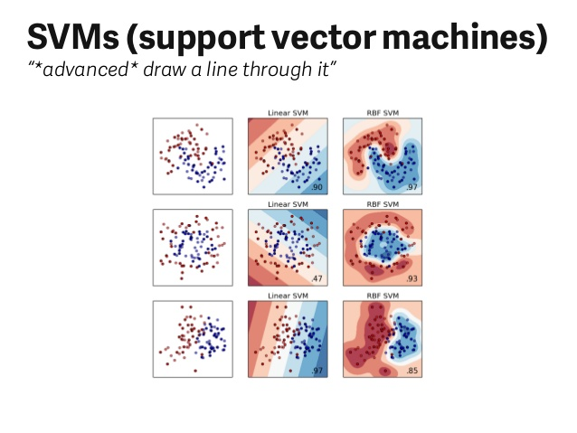

Slide 59
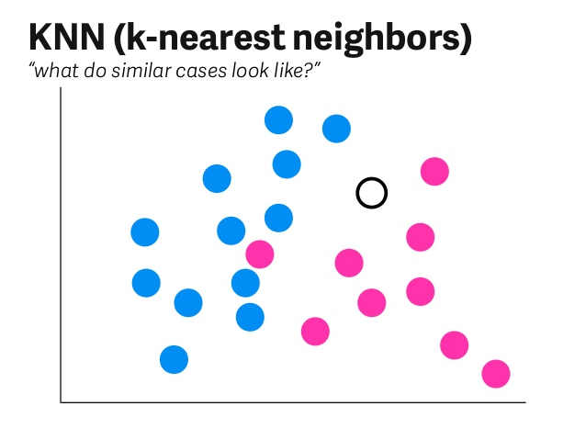

Slide 60
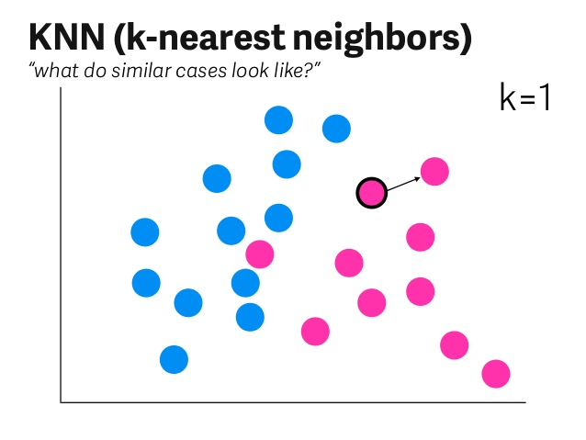

Slide 61
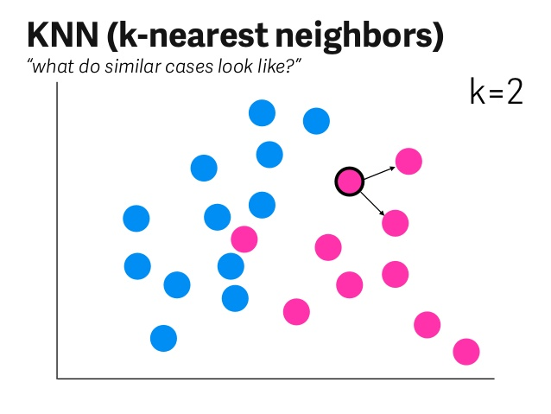

Slide 62
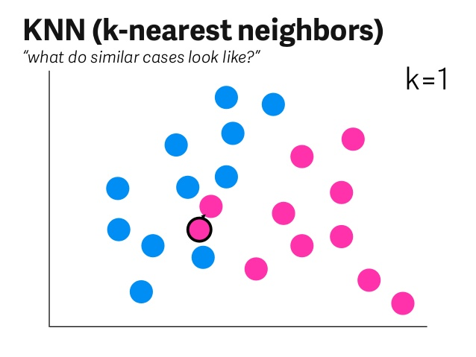

Slide 63
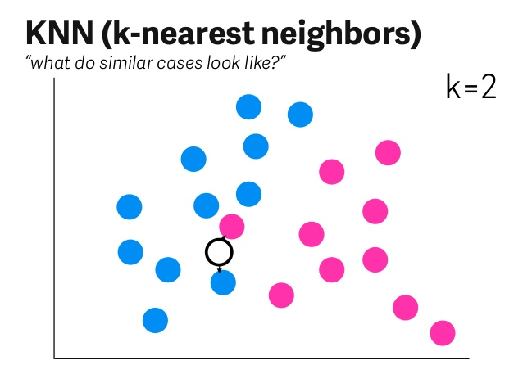

Slide 64


Slide 65
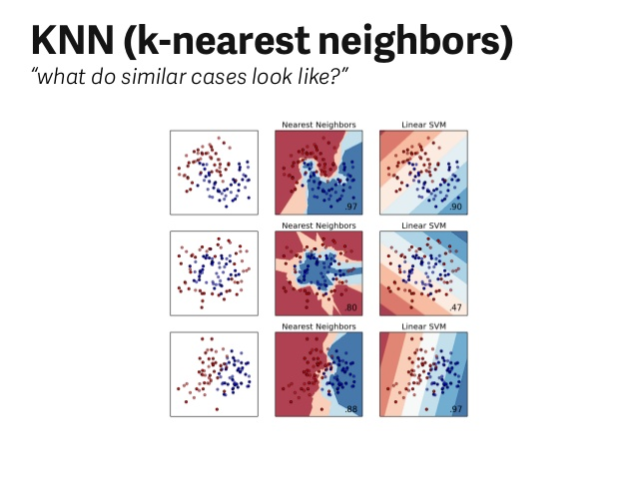

Slide 66
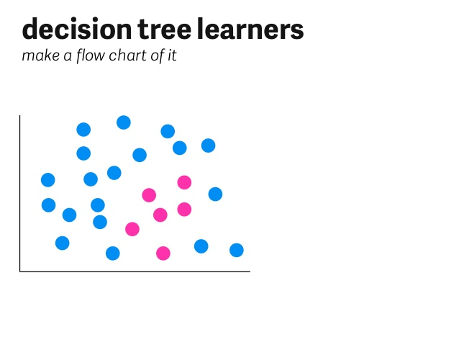

Slide 67
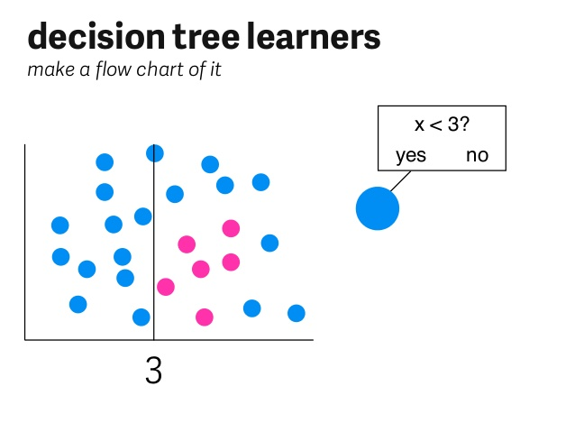

Slide 68
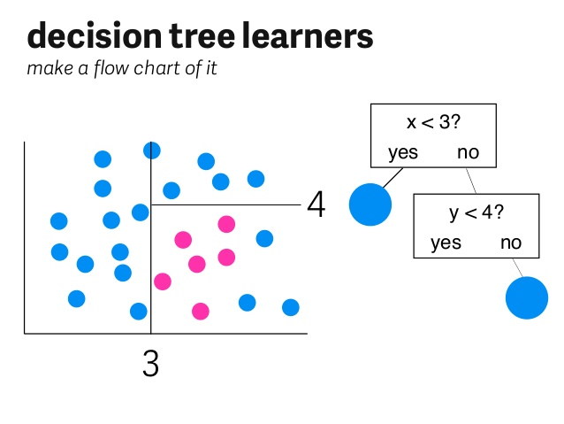

Slide 69
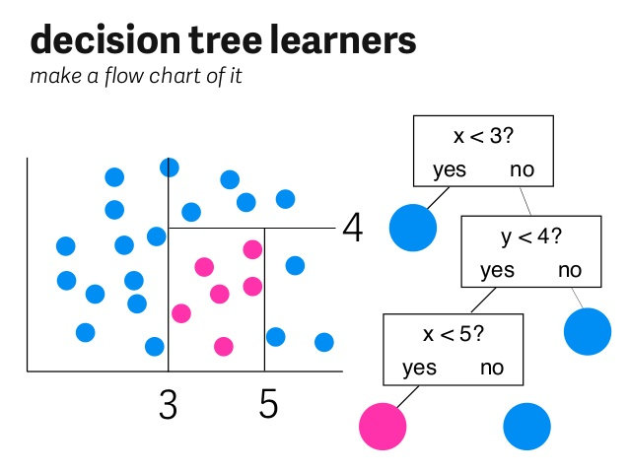

Slide 70
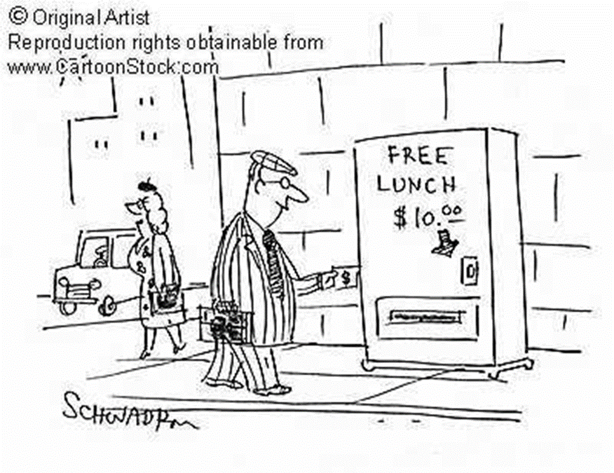
No Free Lunch Theorem
There is a lack of inherent superiority of any classifier
•If we make no prior assumption about the nature of the classification task, is any classification method superior overall?
•Is any algorithm overall superior to random guessing?
•Answer is No to both questions..

Slide 71
No Free Lunch Theorem
Learning algorithm 1 is better than learning algorithm 2 are ultimately statements about the relevant target functions
•Experience with a broad range of techniques is the best insurance for solving arbitrary new classification problems

Slide 72
Thanking You
Sashikant Gupta
Amar Anand
Dipanjan Pan
Debangshu Bhattacharya

